Slide 1
Chapter 2.2
-The Data Link Layer

Slide 2
Data Link layer
Design principles for the Data Link Layer deals with algorithms for achieving reliable, efficient communication of whole units of information called Frames (as opposed to bits – Physical Layer) between two machines.
Two machines are connected by a communication channel that acts conceptually like a wire (e.g., telephone line, coaxial cable, or wireless channel).
Essential property of a channel that makes it “wire-like” connection is that the bits are delivered in exactly the same order in which they are sent.
For ideal channel (no distortion, unlimited bandwidth and no delay) the job of data link layer would be trivial.
However, limited bandwidth, distortions and delay makes this job very difficult.

Slide 3
2.1 Data Link Layer Issues
Network layer services
Framing
Error control
Flow control
Physical layer delivers bits of information to and from data link layer. The functions of Data Link Layer are:
Providing a well-defined service interface to the network layer.
Dealing with transmission errors.
Regulating the flow of data so that slow receivers are not swamped by fast senders.
Data Link layer
Takes the packets from Physical layer, and
Encapsulates them into frames

Slide 4
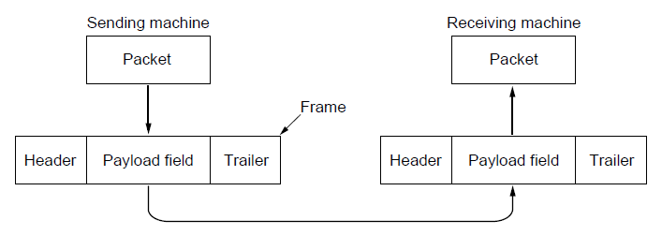
2.1 Data Link Layer Issues
Each frame has a
frame header – a field for holding the packet, and
frame trailer.
Frame Management is what Data Link Layer does.
Relationship between packets and frames

Slide 5
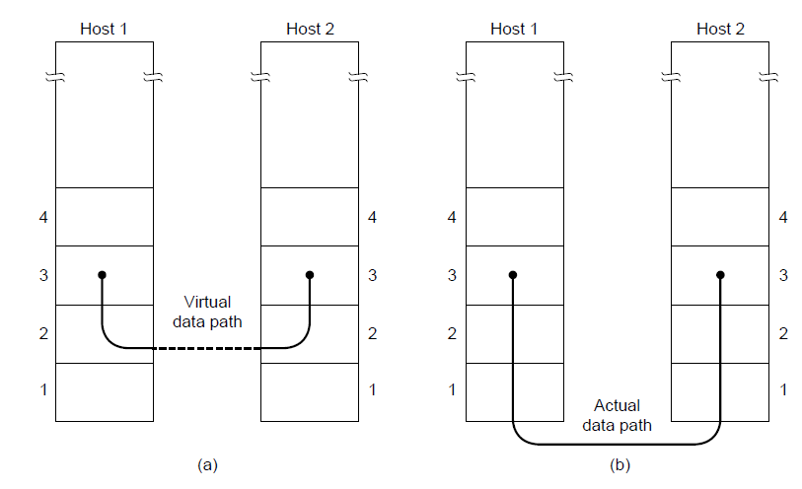
Services Provided to the Network Layer
Principal Service Function of the data link layer is to transfer the data from the network layer on the source machine to the network layer on the destination machine.
Process in the network layer that hands some bits to the data link layer for transmission.
Job of data link layer is to transmit the bits to the destination machine so they can be handed over to the network layer there
(a) Virtual communication (b) Actual communication

Slide 6
Possible Services Offered
Unacknowledged connectionless service.
Acknowledged connectionless service.
Acknowledged connection-oriented service
1.Unacknowledged Connectionless Service:
It consists of having the source machine send independent frames to the destination machine without having the destination machine acknowledge them.
Example: Ethernet, Voice over IP, etc. in all the communication channel were real time operation is more important that quality of transmission.

Slide 7
2. Acknowledged Connectionless Service
Each frame send by the Data Link layer is acknowledged and the sender knows if a specific frame has been received or lost.
Typically the protocol uses a specific time period that if has passed without getting acknowledgment it will re-send the frame.
This service is useful for commutation when an unreliable channel is being utilized (e.g., 802.11 WiFi).
Network layer does not know frame size of the packets and other restriction of the data link layer. Hence it becomes necessary for data link layer to have some mechanism to optimize the transmission.

Slide 8
3. Acknowledged Connection Oriented Service
Source and Destination establish a connection first.
Each frame sent is numbered
Data link layer guarantees that each frame sent is indeed received.
It guarantees that each frame is received only once and that all frames are received in the correct order.
Examples:
Satellite channel communication
Long-distance telephone communication etc.
Three distinct phases:
Connection is established by having both side initialize variables and counters needed to keep track of which frames have been received and which ones have not.
One or more frames are transmitted.
Finally, the connection is released – freeing up the variables, buffers, and other resources used to maintain the connection

Slide 9
Framing
To provide service to the network layer the data link layer must use the service provided to it by physical layer.
Stream of data bits provided to data link layer is not guaranteed to be without errors.
Errors could be:
Number of received bits does not match number of transmitted bits (deletion or insertion)
Bit Value
It is up to data link layer to correct the errors if necessary.
Transmission of the data link layer starts with breaking up the bit stream
into discrete frames
Computation of a checksum for each frame, and
Include the checksum into the frame before it is transmitted.
Receiver computes its checksum error for a receiving frame and if it is different from the checksum that is being transmitted will have to deal with the error.

Slide 10
Framing Methods
Byte count.
Flag bytes with byte stuffing.
Flag bits with bit stuffing.
Physical layer coding violations.

Slide 11
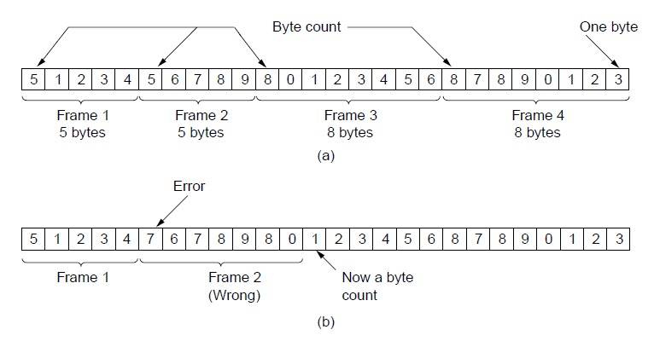
Framing Method 1: Byte Count Framing Method
It uses a field in the header to specify the number of bytes in the frame.
Once the header information is being received it will be used to determine end of the frame.
Trouble with this algorithm is that when the count is incorrectly received the destination will get out of synch with transmission.
Destination may be able to detect that the frame is in error but it does not have a means (in this algorithm) how to correct it.

Slide 12
Framing Method 2:
Flag Bytes with Byte Stuffing Framing Method
This methods gets around the boundary detection of the frame by having each appended by the frame start and frame end special bytes.
If they are the same (beginning and ending byte in the frame) they are called flag byte.
In the next slide figure this byte is shown as FLAG.
If the actual data contains a byte that is identical to the FLAG byte (e.g., picture, data stream, etc.) the convention that can be used is to have escape character inserted just before the “FLAG” character.

Slide 13
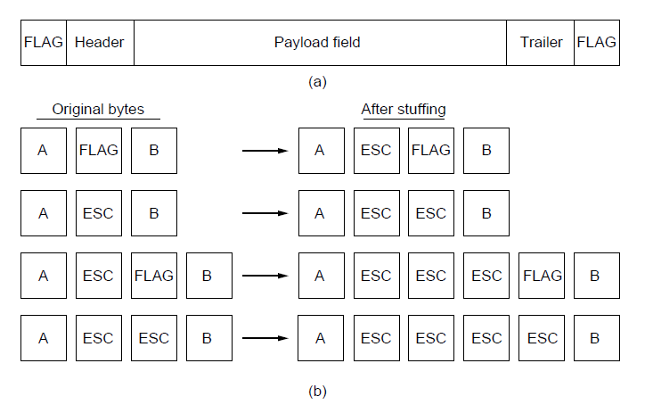
A frame delimited by flag bytes.
Four examples of byte sequences before and after byte stuffing.

Slide 14
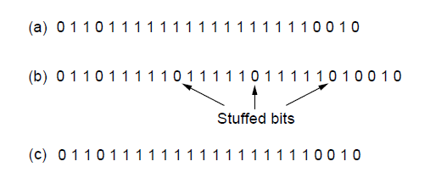
Framing Method 3: Flag Bits with Bit Stuffing Framing Method
This methods achieves the same thing as Byte Stuffing method by using Bits (1) instead of Bytes (8 Bits).
It was developed for High-level Data Link Control (HDLC) protocol.
Each frames begins and ends with a special bit pattern:
01111110 or 0x7E <- Flag Byte
Whenever the sender’s data link layer encounters five consecutive 1s in the data it automatically stuffs a 0 bit into the outgoing bit stream.
USB uses bit stuffing.
Bit stuffing. (a) The original data.
(b) The data as they appear on the line.
(c) The data as they are stored in the receiver’s memory after destuffing.

Slide 15
Framing
Many data link protocols use a combination of presented methods for safety.
For example in Ethernet and 802.11 each frame begin with a well-defined pattern called a preamble.
Preamble is typically 72 bits long.
It is then followed by a length field.

Slide 16
Error Control
After solving the marking of the frame with start and end the data link layer has to handle eventual errors in transmission or detection.
Ensuring that all frames are delivered to the network layer at the destination and in proper order.
Unacknowledged connectionless service: it is OK for the sender to output frames regardless of its reception.
Reliable connection-oriented service: it is NOT OK.
Reliable connection-oriented service usually will provide a sender with some feedback about what is happening at the other end of the line.
Receiver Sends Back Special Control Frames.
If the Sender Receives positive Acknowledgment it will know that the frame has arrived safely.
Timer and Frame Sequence Number for the Sender is Necessary to handle the case when there is no response (positive or negative) from the Receiver .

Slide 17
Flow Control
Important Design issue for the cases when the sender is running on a fast powerful computer and receiver is running on a slow low-end machine.
Two approaches:
Feedback-based flow control
Rate-based flow control
1. Feedback-based Flow Control:
Receiver sends back information to the sender giving it permission to send more data, or
Telling sender how receiver is doing.
2. Rate-based Flow Control:
Built in mechanism that limits the rate at which sender may transmit data, without the need for feedback from the receiver.

Slide 18
Error Detection and Correction
Two basic strategies to deal with errors:
Include enough redundant information to enable the receiver to deduce what the transmitted data must have been. Error correcting codes.
Include only enough redundancy to allow the receiver to deduce that an error has occurred (but not which error). Error detecting codes.

Slide 19
Error Detection and Correction
Error codes are examined in Link Layer because this is the first place that we have run up against the problem of reliability transmitting groups of bits.
Codes are reused because reliability is an overall concern.
The error correcting code are also seen in the physical layer for noise channels.
Commonly they are used in link, network and transport layer.
Error codes have been developed after long fundamental research conducted in mathematics.
Many protocol standards get codes from the large field in mathematics.

Slide 20
Error Detection & Correction Code (1)
Hamming codes.
Binary convolutional codes.
Reed-Solomon codes.
Low-Density Parity Check codes.

Slide 21
Error Detection & Correction Code
All the codes presented in previous slide add redundancy to the information that is being sent.
A frame consists of
m data bits (message) and
r redundant bits (check).
Block code - the r check bits are computed solely as function of the m data bits with which they are associated.
Systemic code – the m data bits are send directly along with the check bits.
Linear code – the r check bits are computed as a linear function of the m data bits.

Slide 22
Error Detection & Correction Code
n – total length of a block (i.e., n = m + r)
(n, m) – code
n – bit codeword containing n bits.
m/n – code rate (range ½ for noisy channel and close to 1 for high-quality channel).
Example
Transmitted: 10001001
Received: 10110001
XOR operation gives number of bits that are different.
XOR: 00111000
Number of bit positions in which two codewords differ is called Hamming Distance. It shows that two codes are d distance apart, and it will require d errors to convert one into the other.

Slide 23
Error Detection & Correction Code
All 2^{m} possible data messages are legal, but due to the way the check bits are computers not all 2^{n} possible code words are used.
Only small fraction of 2^{m}/2^{n}=1/2^{r} are possible will be legal codewords.
The error-detecting and error-correcting codes of the block code depend on this Hamming distance.
To reliably detect d error, one would need a distance d+1 code.
To correct d error, one would need a distance 2d+1 code.

Slide 24
Error Detection & Correction Code
Example:
4 valid codes:
0000000000
0000011111
1111100000
1111111111
Minimal Distance of this code is 5 => can correct and double errors and it detect quadruple errors.
0000000111 => single or double – bit error. Hence the receiving end must assume the original transmission was 0000011111.
0000000000 => had triple error that was received as 0000000111 it would be detected in error.

Slide 25
Error Detection & Correction Code
One cannot perform double errors and at the same time detect quadruple errors.
Error correction requires evaluation of each candidate codeword which may be time consuming search.
Through design this search time can be minimized.
In theory if n = m + r, this requirement becomes:
(m + r + 1) ≤ 2^{r}

Slide 26
1. Hamming Code
Codeword: b1 b2 b3 b4 ….
Check bits: The bits that are powers of 2 (p1, p2, p4, p8, p16, …).
The rest of bits (m3, m5, m6, m7, m9, …) are filled with m data bits.
Example of the Hamming code with m = 7 data bits and r = 4 check bits is given in the next slide.
Consider a message having four data bits (D) which is to be transmitted as a 7-bit codeword by adding three error control bits. This would be called a (7,4) code. The three bits to be added are three EVEN Parity bits (P), where the parity of each is computed on different subsets of the message bits as shown below.
7 | 6 | 5 | 4 | 3 | 2 | 1
D | D | D | P | D | P | P | 7-BIT CODEWORD
D | - | D | - | D | - | P | (EVEN PARITY)
D | D | - | - | D | P | - | (EVEN PARITY)
D | D | D | P | - | - | - | (EVEN PARITY)

Slide 27
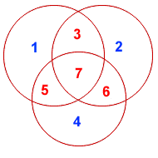
Hamming Code
Why Those Bits? - The three parity bits (1,2,4) are related to the data bits (3,5,6,7) as shown at right. In this diagram, each overlapping circle corresponds to one parity bit and defines the four bits contributing to that parity computation. For example, data bit 3 contributes to parity bits 1 and 2. Each circle (parity bit) encompasses a total of four bits, and each circle must have EVEN parity. Given four data bits, the three parity bits can easily be chosen to ensure this condition.
It can be observed that changing any one bit numbered 1..7 uniquely affects the three parity bits. Changing bit 7 affects all three parity bits, while an error in bit 6 affects only parity bits 2 and 4, and an error in a parity bit affects only that bit. The location of any single bit error is determined directly upon checking the three parity circles.

Slide 28
Hamming Code
For example, the message 1101 would be sent as 1100110, since:
7 | 6 | 5 | 4 | 3 | 2 | 1
1 | 1 | 0 | 0 | 1 | 1 | 0 | 7-BIT CODEWORD
1 | - | 0 | - | 1 | - | 0 | (EVEN PARITY)
1 | 1 | - | - | 1 | 1 | - | (EVEN PARITY)
1 | 1 | 0 | 0 | - | - | - | (EVEN PARITY)

Slide 29
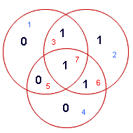
Hamming Codes
When these seven bits are entered into the parity circles, it can be confirmed that the choice of these three parity bits ensures that the parity within each circle is EVEN, as shown here.

Slide 30
Hamming Codes
It may now be observed that if an error occurs in any of the seven bits, that error will affect different combinations of the three parity bits depending on the bit position.
For example, suppose the above message 1100110 is sent and a single bit error occurs such that the codeword 1110110 is received:
transmitted message received message
1 1 0 0 1 1 0 ------------> 1 1 1 0 1 1 0
BIT: 7 6 5 4 3 2 1 BIT: 7 6 5 4 3 2 1
The above error (in bit 5) can be corrected by examining which of the three parity bits was affected by the bad bit:
7 | 6 | 5 | 4 | 3 | 2 | 1
1 | 1 | 1 | 0 | 1 | 1 | 0 | 7-BIT CODEWORD
1 | - | 1 | - | 1 | - | 0 | (EVEN PARITY) | NOT! | 1
1 | 1 | - | - | 1 | 1 | - | (EVEN PARITY) | OK! | 0
1 | 1 | 1 | 0 | - | - | - | (EVEN PARITY) | NOT! | 1

Slide 31
Hamming Code
In fact, the bad parity bits labeled 101 point directly to the bad bit since 101 binary equals 5. Examination of the 'parity circles' confirms that any single bit error could be corrected in this way.
For Detection of Errors: d_{min} > = S+1 , For hammimg code d_{min} =3 (from the property of Hamming Code)
Hence S=2 which indicated that HC detects 2 errors.
For Correction of errors: d_{min} <= 2t+1, if we put d_{min} =3, we get t=1 which indicate HC can correct single bit error.
The value of the Hamming code can be summarized:
Detection of 2 bit errors (assuming no correction is attempted);
Correction of single bit errors;
Cost of 3 bits added to a 4-bit message.
The ability to correct single bit errors comes at a cost which is less than sending the entire message twice. (Recall that simply sending a message twice accomplishes no error correction.)

Slide 32
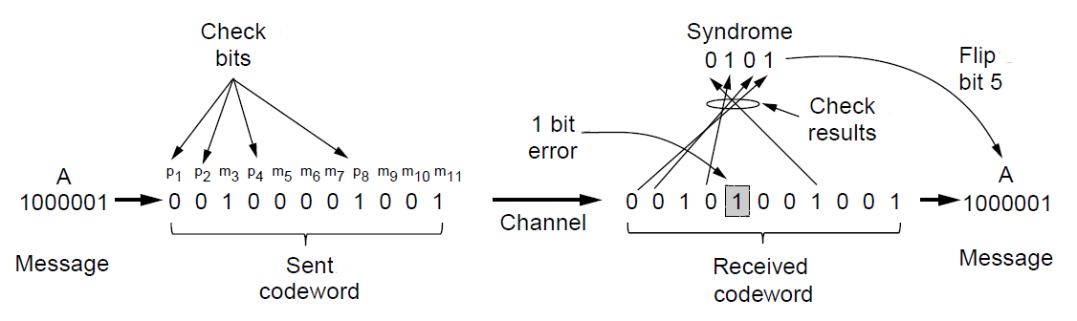
Hamming Code
Example of an (11, 7) Hamming code correcting a single-bit error.

Slide 33
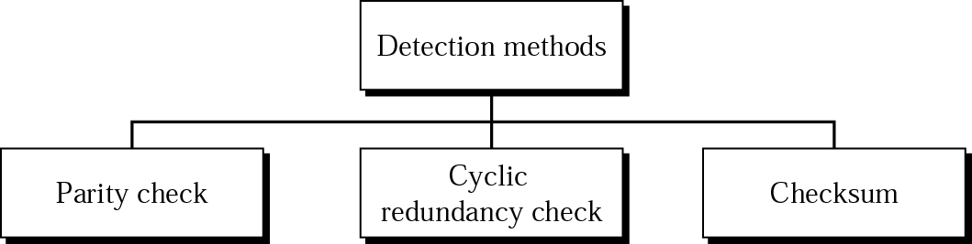
Error-Detecting Codes
Three different types of error detecting codes which are Linear, systematic block codes are
Parity.
Checksums.
Cyclic Redundancy Checks (CRCs).

Slide 34
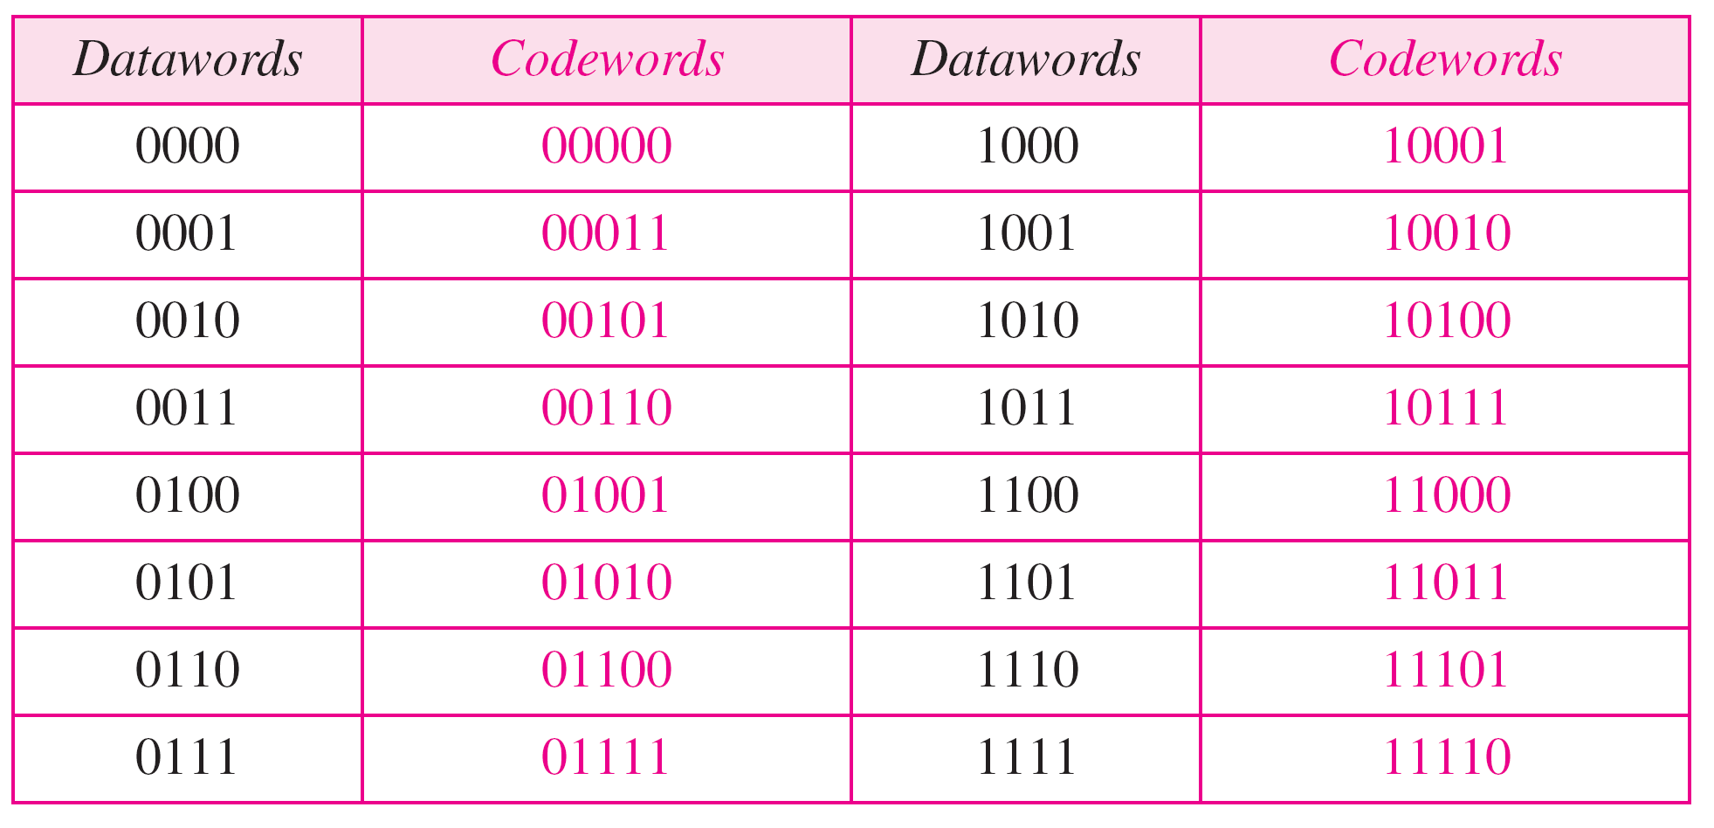
1. Parity Check
A k-bit dataword is changed to an n-bit codeword where n = k + 1.
The extra bit (called the parity bit), is selected to make the total number of 1s in the codeword even.
The minimum Hamming distance d_{min} = 2, which means that the code is a single-bit error-detecting code.
Example of parity-check code with k = 4, n = 5; C (5,4) :

Slide 35
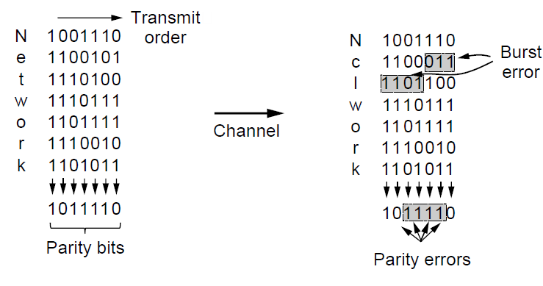
Parity Codes
Interleaving of parity bits to detect a burst error.

Slide 36
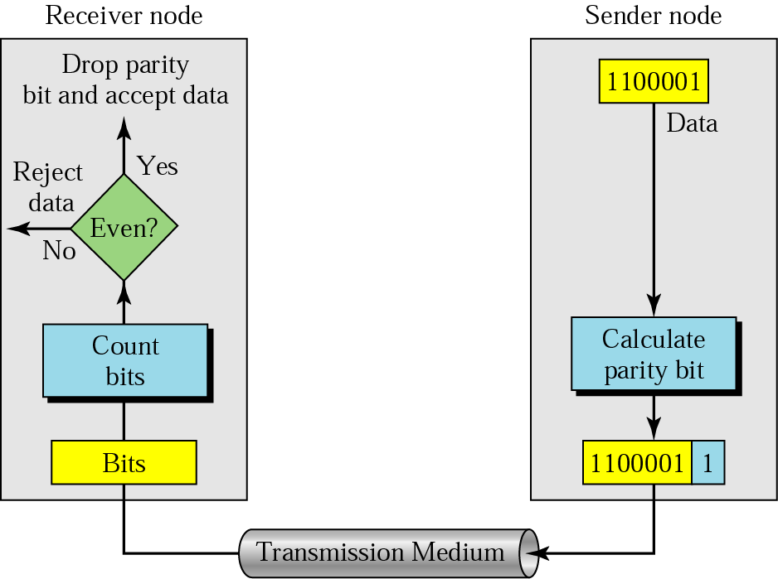
Even-parity concept
A parity bit is added to every data unit so that the total number of 1s is even (or odd for odd-parity).

Slide 37
Example 1
Suppose the sender wants to send the word world. In ASCII the five characters are coded as
1110111 1101111 1110010 1101100 1100100
The following shows the actual bits sent
11101110 11011110 11100100 11011000 11001001

Slide 38
Example 2
Now suppose the word world in Example 1 is received by the receiver without being corrupted in transmission.
11101110 11011110 11100100 11011000 11001001
The receiver counts the 1s in each character and comes up with even numbers (6, 6, 4, 4, 4).
Result: The data are accepted.

Slide 39
Example 3
Now suppose the word world in Example 1 is corrupted during transmission.
11111110 11011110 11101100 11011000 11001001
The receiver counts the 1s in each character and comes up with even and odd numbers (7, 6, 5, 4, 4).
Result: The receiver knows that the data are corrupted, discards them, and asks for retransmission.

Slide 40
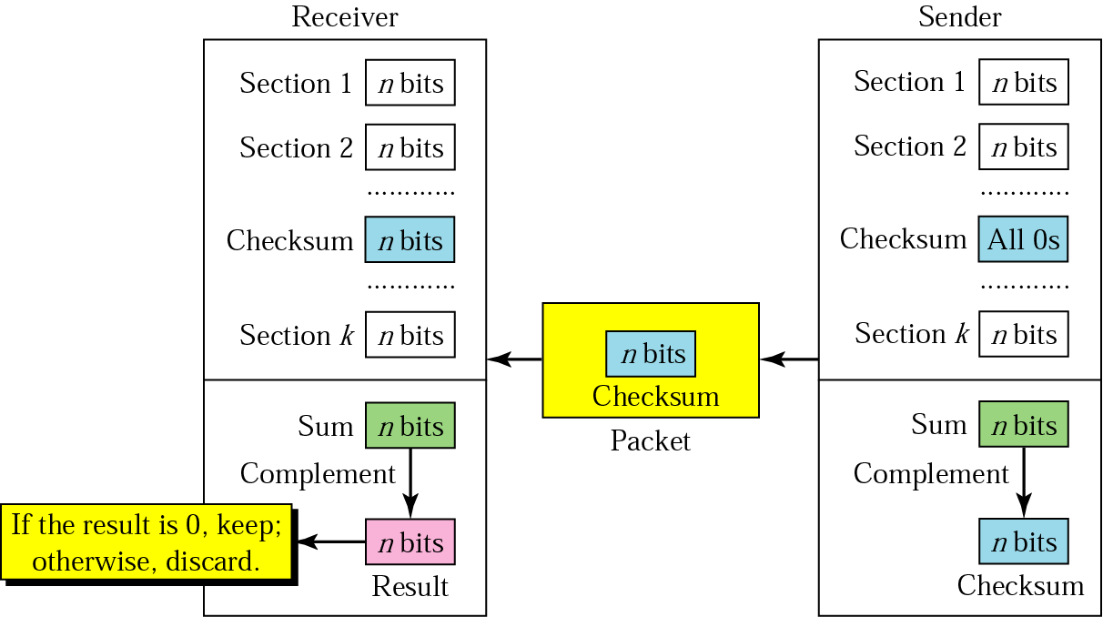
2. Checksum
The receiver follows these steps:
The unit is divided into k sections, each of n bits.
All sections are added using one’s complement to get the sum.
The sum is complemented.
If the result is zero, the data are accepted: otherwise, rejected
The sender follows these steps:
The unit is divided into k sections, each of n bits.
All sections are added using one’s complement to get the sum.
The sum is complemented and becomes the checksum.
The checksum is sent with the data.

Slide 41
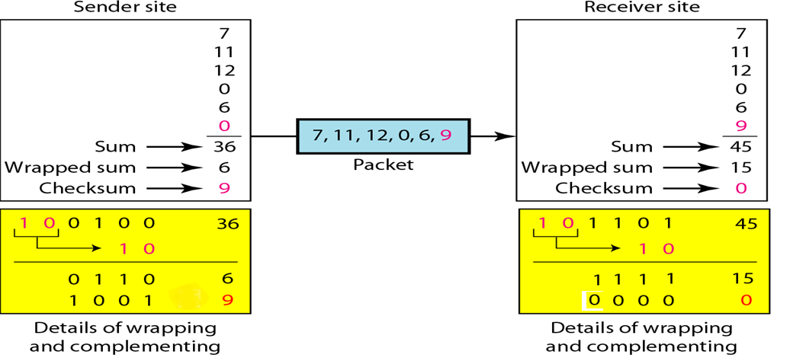
Implementation of checksum
The sender initializes the checksum to 0 and adds all data items and the checksum.
36 cannot be expressed in 4 bits. The extra two bits are wrapped and added with the sum to create the wrapped sum value 6.
The sum is then complemented, resulting in the checksum value 9 (15 − 6 = 9).
Notes:
‹#›

Slide 42
2. Checksum
Internet checksum
Sender site:
1. The message is divided into 16-bit words.
2. The value of the checksum word is set to 0.
3. All words including the checksum are added using one’s complement addition.
4. The sum is complemented and becomes the checksum.
5. The checksum is sent with the data.
Receiver site:
1. The message (including checksum) is divided into 16-bit words.
2. All words are added using one’s complement addition.
3. The sum is complemented and becomes the new checksum.
4. If the value of checksum is 0, the message is accepted; otherwise, it is rejected.
Notes:
‹#›

Slide 43
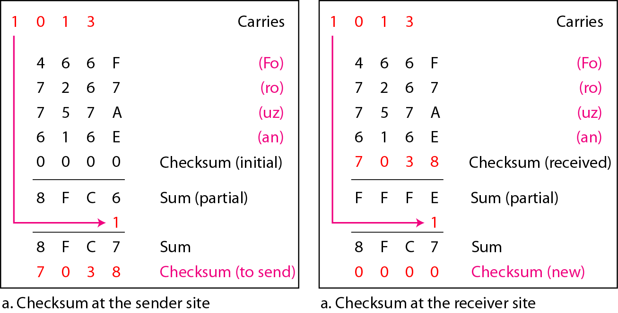
2. Checksum
Internet checksum : Example
Notes:
‹#›

Slide 44
Example
Suppose the following block of 16 bits is to be sent using a checksum of 8 bits. 10101001 00111001
The numbers are added using one’s complement
10101001
00111001 ------------ Sum 11100010
Checksum 00011101
The pattern sent is 10101001 00111001 00011101

Slide 45
Example
Now suppose the receiver receives the pattern sent in previous Example and there is no error. 10101001 00111001 00011101
When the receiver adds the three sections, it will get all 1s, which, after complementing, is all 0s and shows that there is no error.
10101001
00111001
00011101
Sum 11111111
Complement 00000000 means that the pattern is OK.

Slide 46
Example
Now suppose there is a burst error of length 5 that affects 4 bits.
10101111 11111001 00011101
When the receiver adds the three sections, it gets
10101111
11111001
00011101
Partial Sum 1 11000101
Carry 1
Sum 11000110
Complement 00111001 the pattern is corrupted.

Slide 47
3. Cyclic Redundancy Checks (CRCs)
Cyclic codes are special linear block code.
If a codeword is cyclically shifted (rotated), the result is another codeword.
Ex : 1011000 is a codeword and if cyclically left-shifted, the result 0110001 is also a codeword.
Cyclic Redundancy Check
The use of cyclic codes to detect and correct error

Slide 48
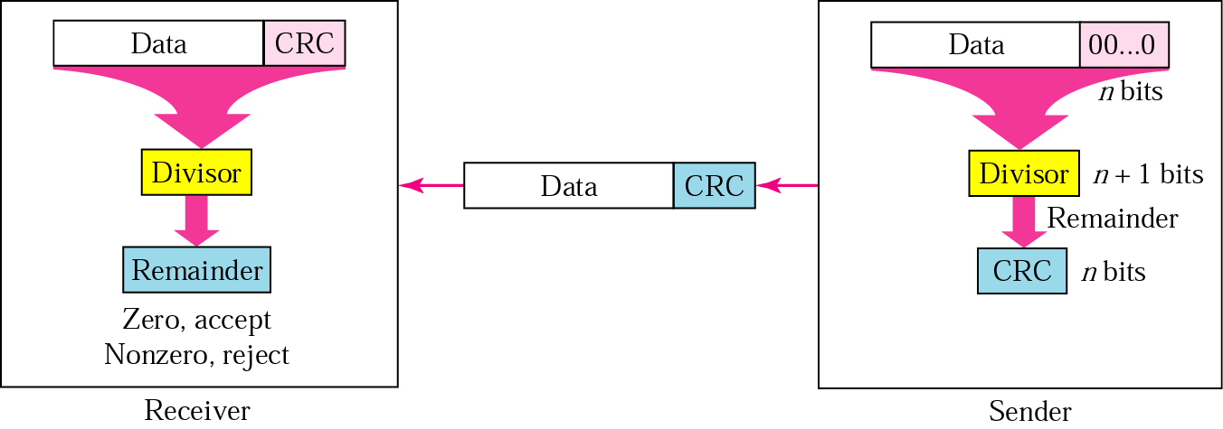
3. Cyclic Redundancy Checks (CRCs)
CRC generator and checker

Slide 49
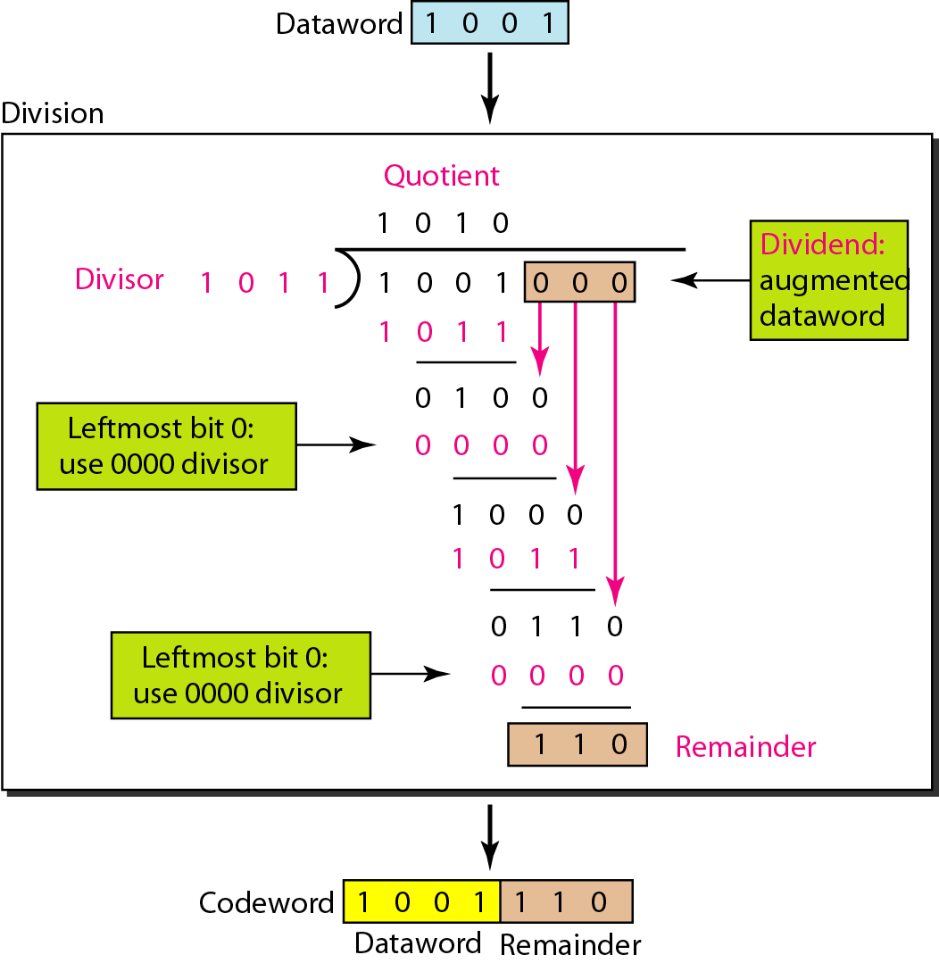
3. Cyclic Redundancy Checks (CRCs)
Example : Division in CRC Encoder
Notes:
‹#›

Slide 50
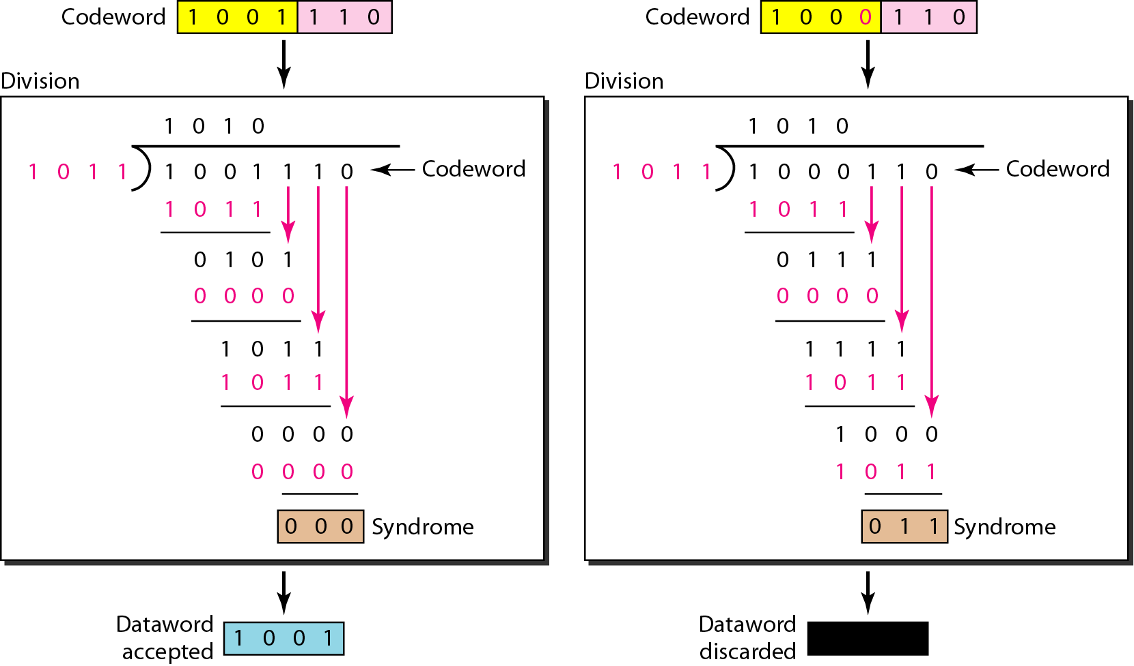
3. Cyclic Redundancy Checks (CRCs)
Example : Division in CRC Decoder
Notes:
‹#›

Slide 51
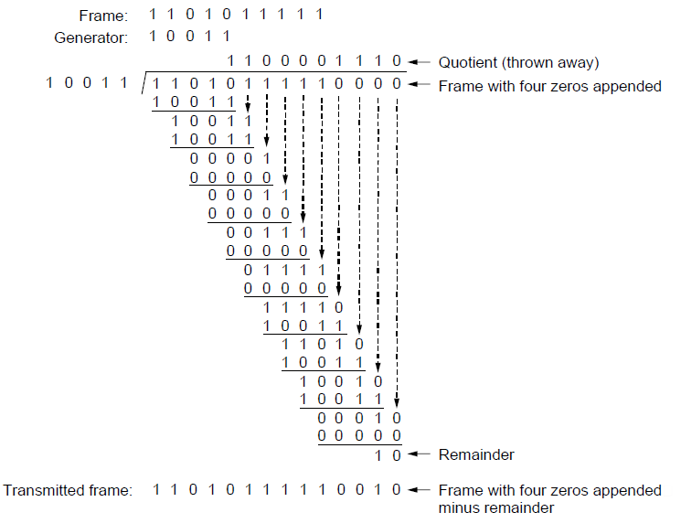
3. Cyclic Redundancy Checks (CRCs)
Example calculation of the CRC

Slide 52
DATA LINK PROTOCOLS
Introduction
Simplex protocol
Stop and wait protocol (Error free channel)
Stop and wait protocol (Noisy channel)
Sliding Window Protocol
Go Back N protocol
Selective Repeat Protocol
Examples of Data Link Protocols

